Slide 1

Department of Electrical and Computer Engineering
CSE 299
Faculty:Intisar Tahmid Naheen(ITN)
Section: 12
Group:08
Submitted by
Farzia Chowdhury (1522115642)
Md. Seragis Salekin (1632228042)
Md.Fuadul Islam (1631135542)

Slide 2
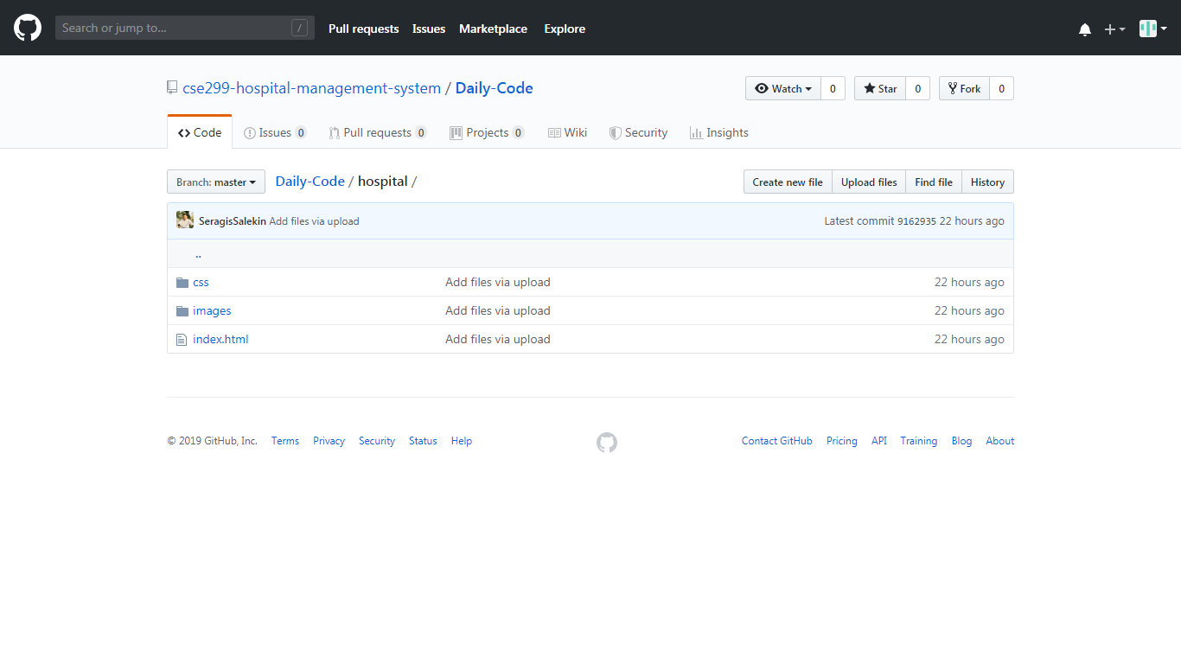

Slide 3
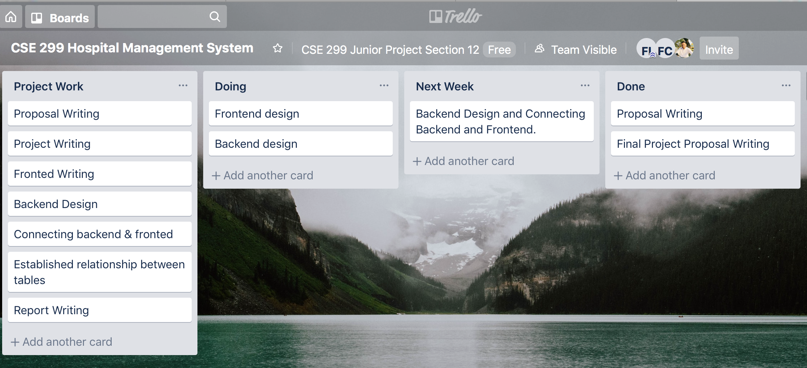

Slide 5
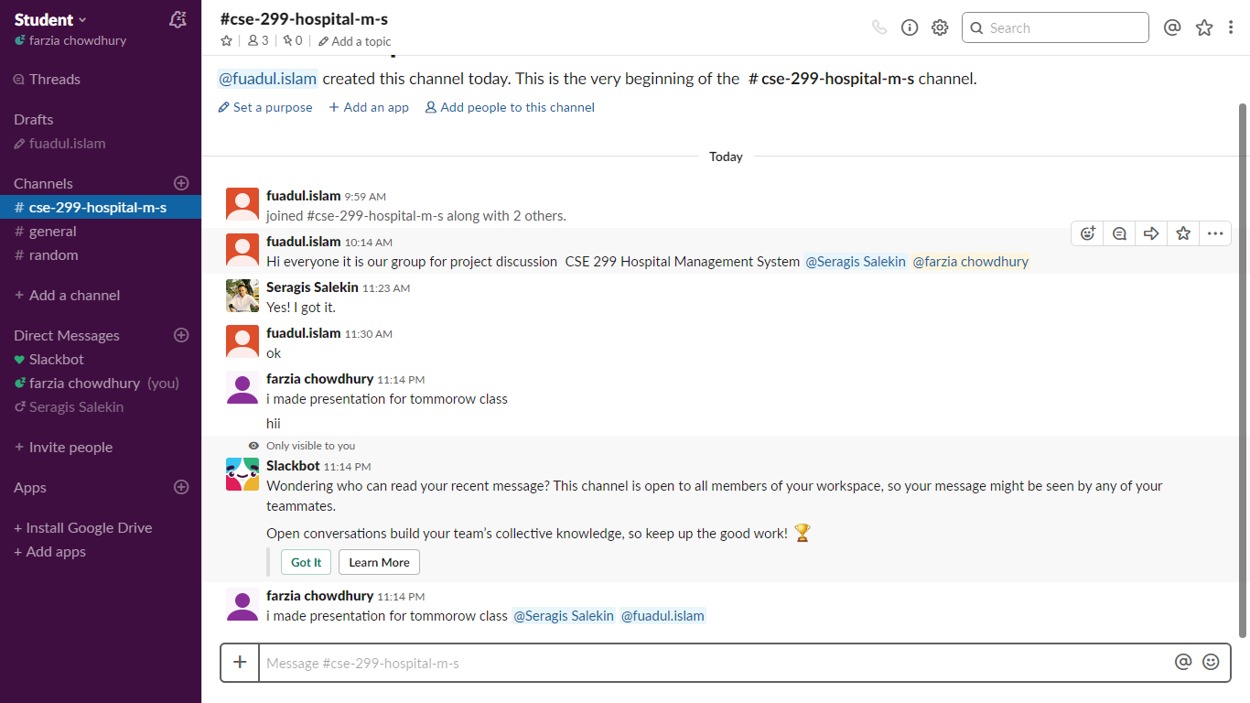

Slide 6
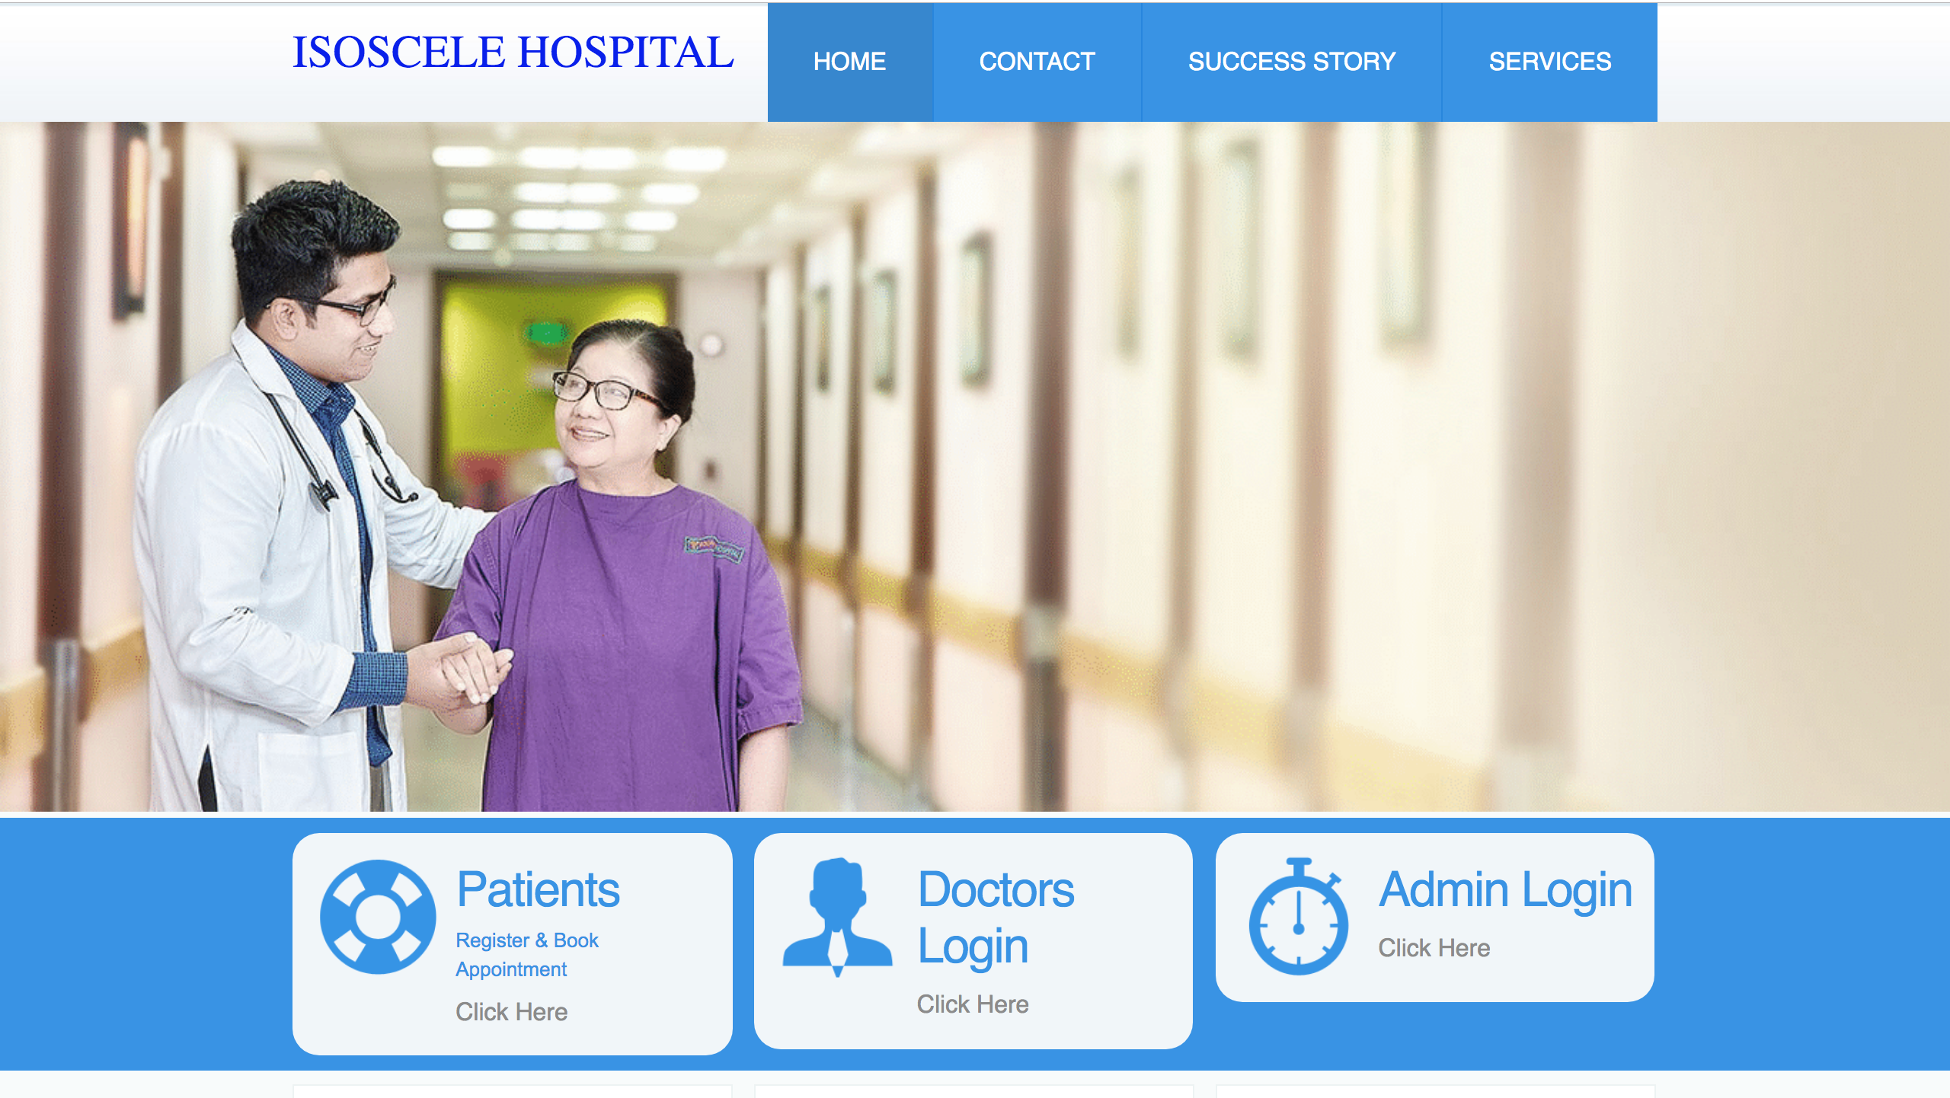
Link

